Slide 1
Problem Statement No.7 – AI Agent for Digital Financial Literacy
AICTE IBM CLOUD PROJECT
Presented By:
Student Name :- UDDIP BISHT
College Name : - PANIPAT INSTITUTE OF ENGINEERING & TECHNOLOGY COLLEGE
Department : - B.TECH ( COMPUTER SCIENCE & ENGINEERING )

Slide 2
OUTLINE
Problem Statement
Technology used
Wow factor
End users
Result
Conclusion
Git-hub Link
Future scope
IBM Certifications

Slide 3
Problem Statement
To build an AI Agent powered by Retrieval-Augmented Generation (RAG) that enhances digital financial literacy by retrieving trustworthy content related to UPI, online scams, interest rates, budgeting, and personal finance from government and educational platforms. The agent aims to educate users and make digital finance inclusive, safe, and easy to understand.

Slide 4
Technology used
🧠 Technologies Used :-
IBM Watsonx.ai Studio
IBM Granite Foundation Model (LLM)
Vector Index for RAG
PDF documents from RBI/NPCI/official sources
Natural Language Processing (NLP)
IBM Cloud Object Storage

Slide 5
IBM cloud services used
☁️ IBM Cloud Services Used :-
Watsonx.ai Studio
IBM Granite Model
Watsonx Vector Index
IBM Cloud Lite Account
IBM Cloud IAM
IBM Cloud Object Storage

Slide 6
Wow factors
✅ Uses RAG to fetch answers from RBI/NPCI PDFs
✅ Fully hosted on IBM Cloud
✅ Handles unrelated questions gracefully
✅ Multilingual-ready with Watson Translator
✅ Educates users on digital financial safety
✅ Personalized & secure financial advice

Slide 7
End users
General public seeking financial clarity
Rural & semi-urban citizens
Students & young professionals
First-time UPI and digital banking users
NGOs & government outreach programs
Self-help groups / women collectives
Customer service centers
Educators / Institutions

Slide 8
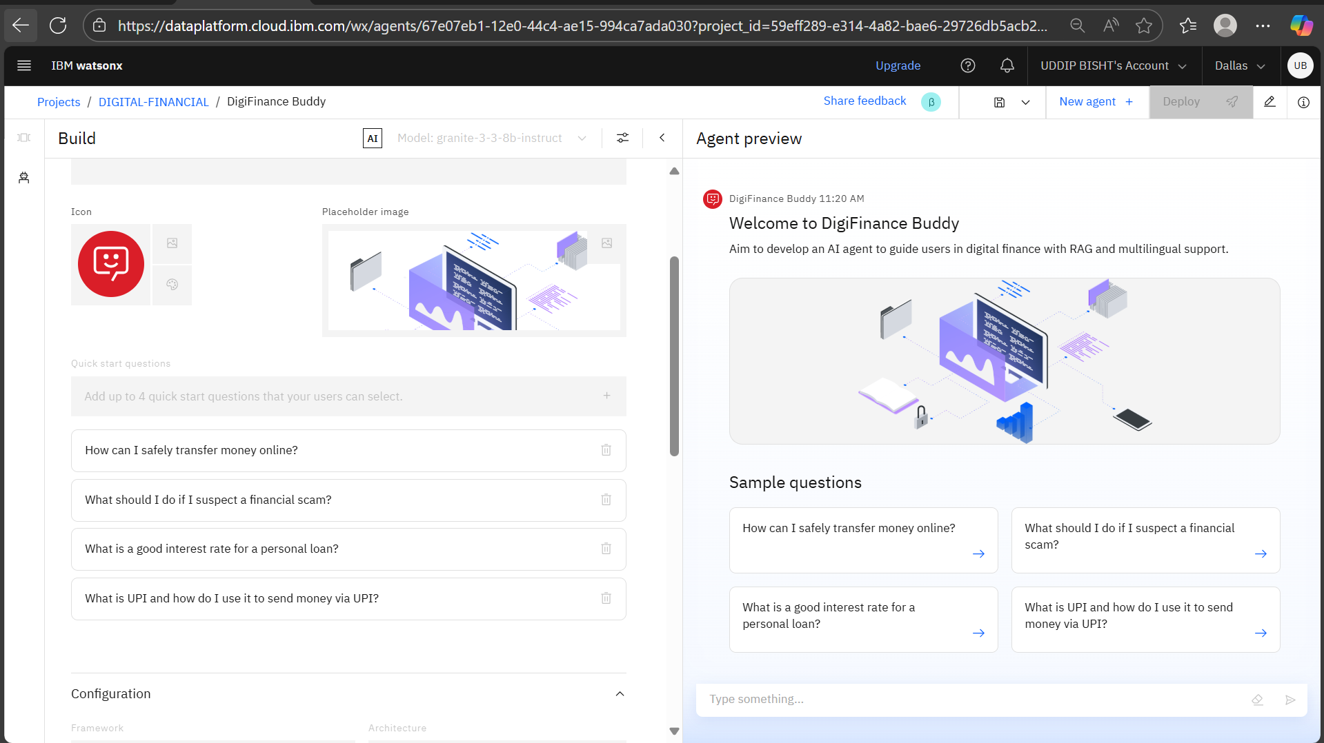
Result

Slide 9
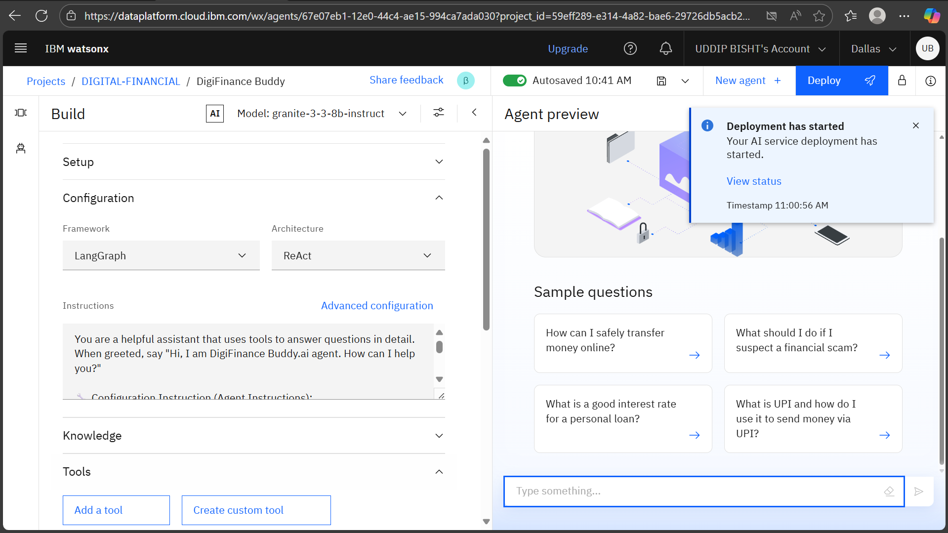
Result

Slide 10
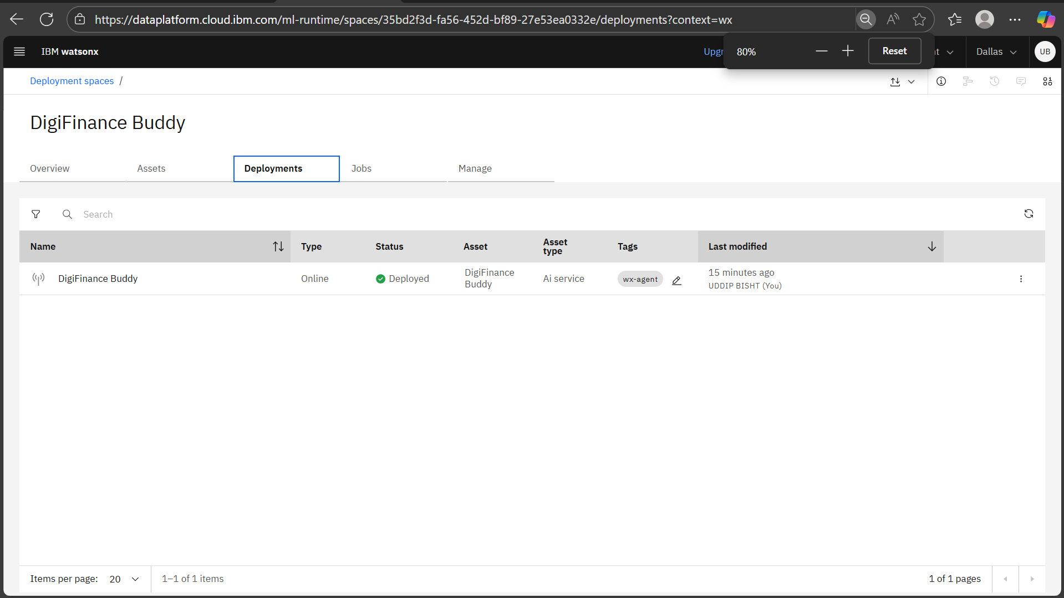
Result

Slide 11
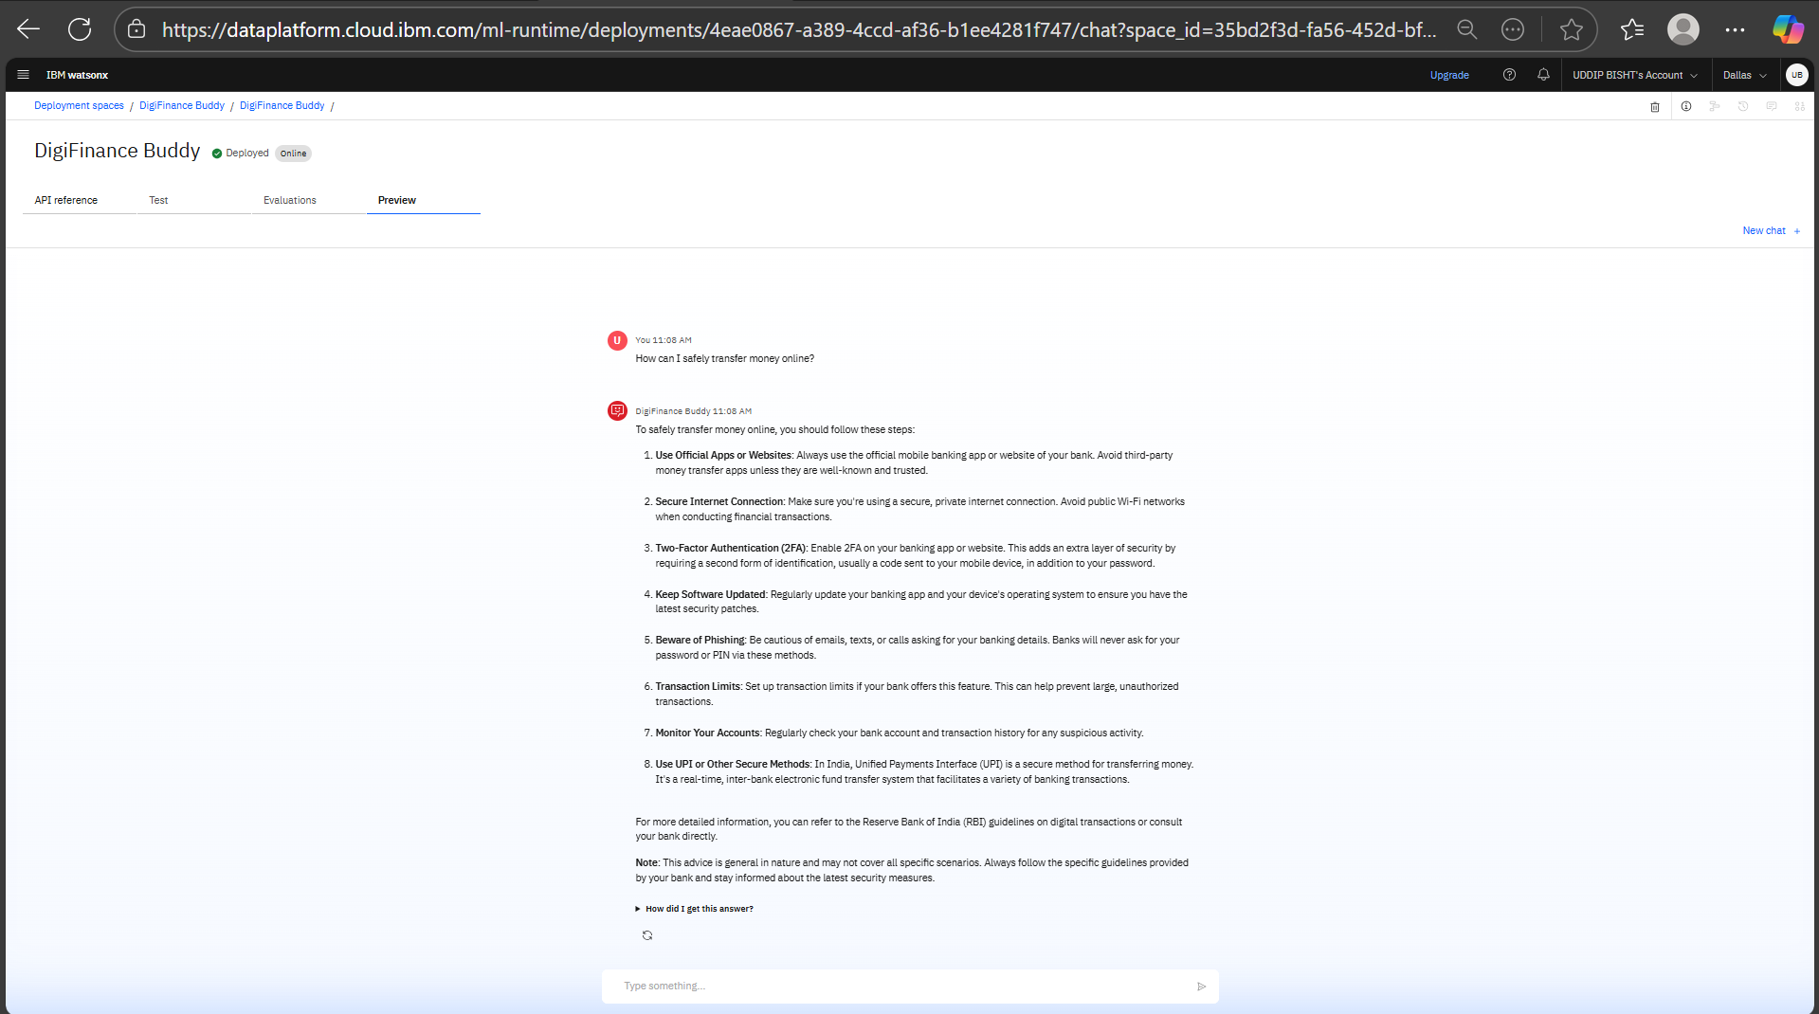
Result

Slide 12
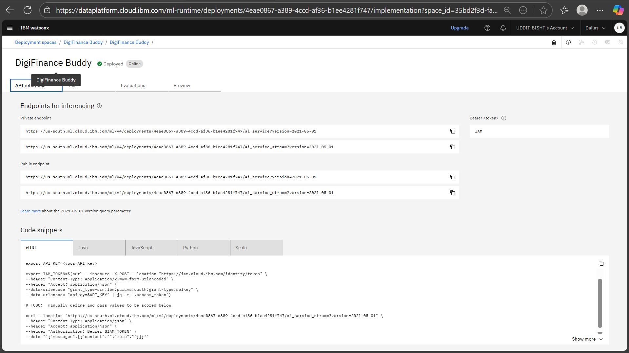
Result

Slide 13
Conclusion
The AI Agent for Digital Financial Literacy successfully addresses the gap in accessible, trustworthy, and multilingual financial education. By leveraging IBM Watsonx.ai and RAG architecture, the system provides real-time, document-backed answers to users in natural language. It helps reduce fraud risk, increases financial confidence, and promotes digital inclusion across diverse user groups.
This AI-driven RAG-based assistant ensures financial literacy is not only informative but also accessible, reliable, and culturally inclusive. With verified data sources, multilingual interaction, and IBM's AI cloud ecosystem, DigiFinance Buddy builds confidence in users to safely navigate the digital finance landscape.

Slide 14
GitHub Link
GitHub repo Link :-
https://github.com/uddipbisht/AI-Agent-for-Digital-Financial-Literacy-Project.git

Slide 15
Future scope
🛣️ Future Scope
📱 WhatsApp or mobile app integration
🗣️ Voice input (speech-to-text)
📊 Auto-generated financial summaries
📰 Region-based financial updates
🌐 Expanded multilingual support

Slide 16
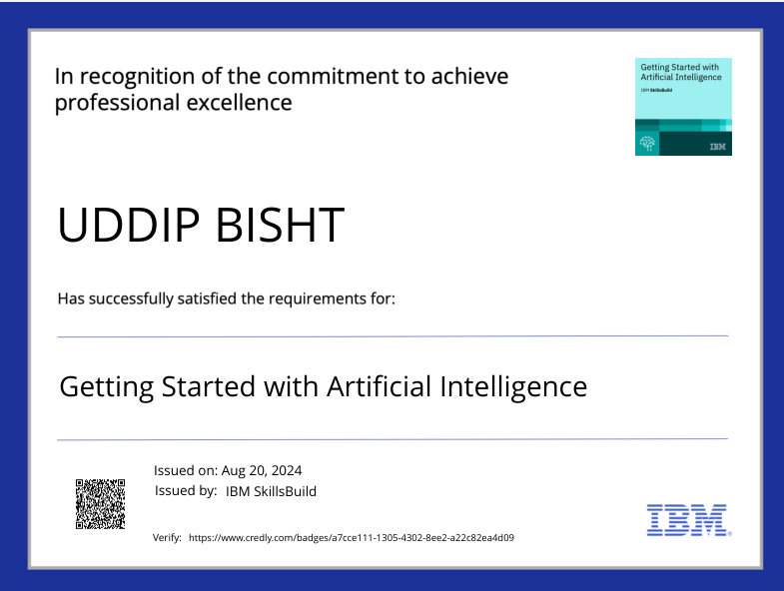
IBM Certifications
Certificate (getting started with AI)

Slide 17
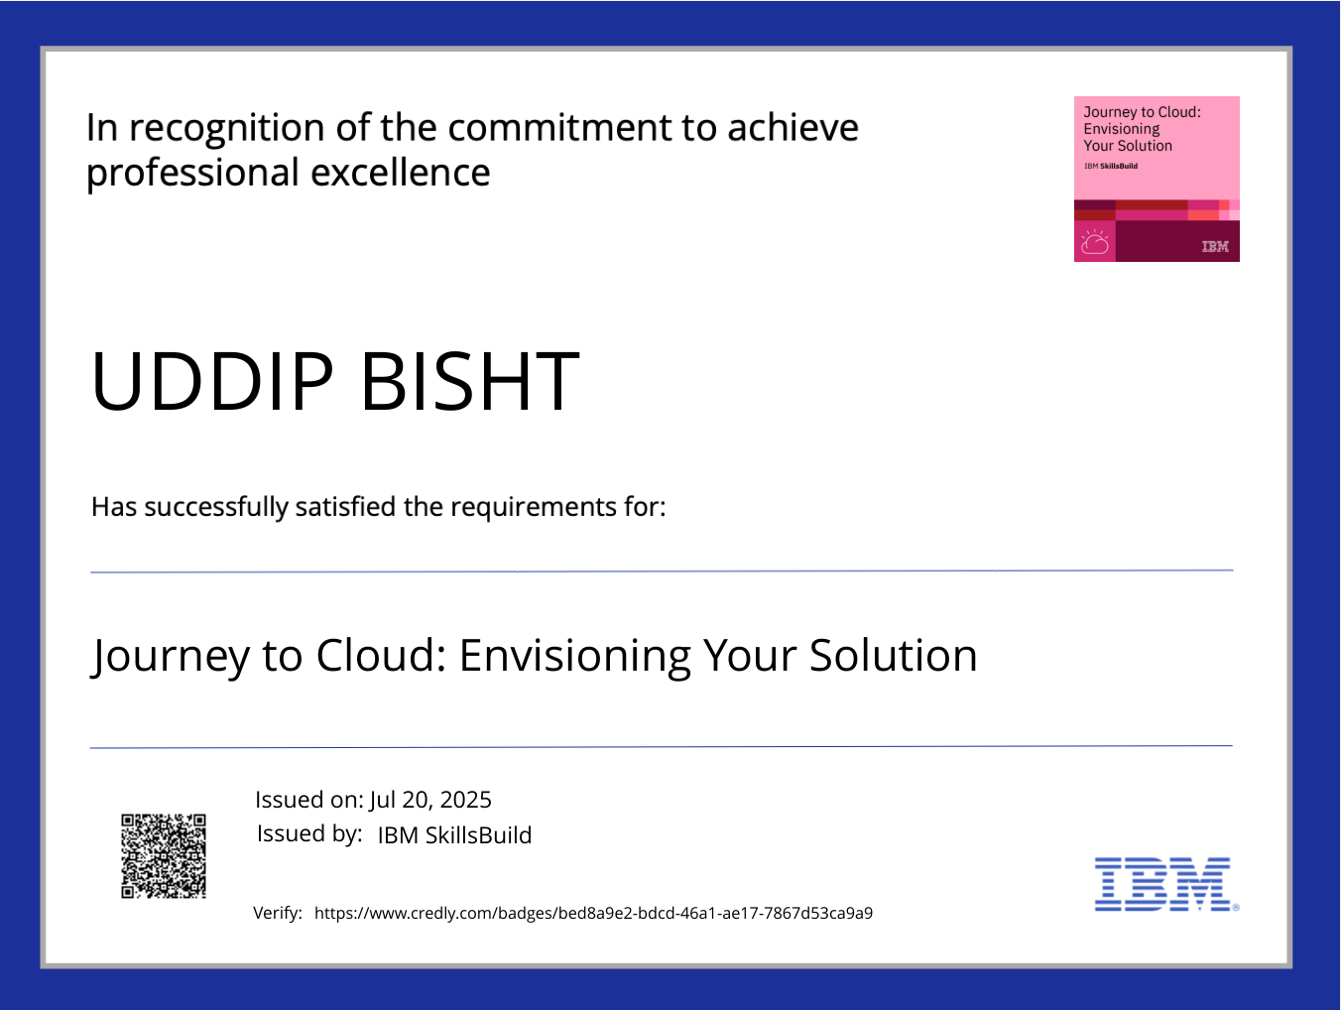
IBM Certifications
Certificate (Journey to Cloud)

Slide 18
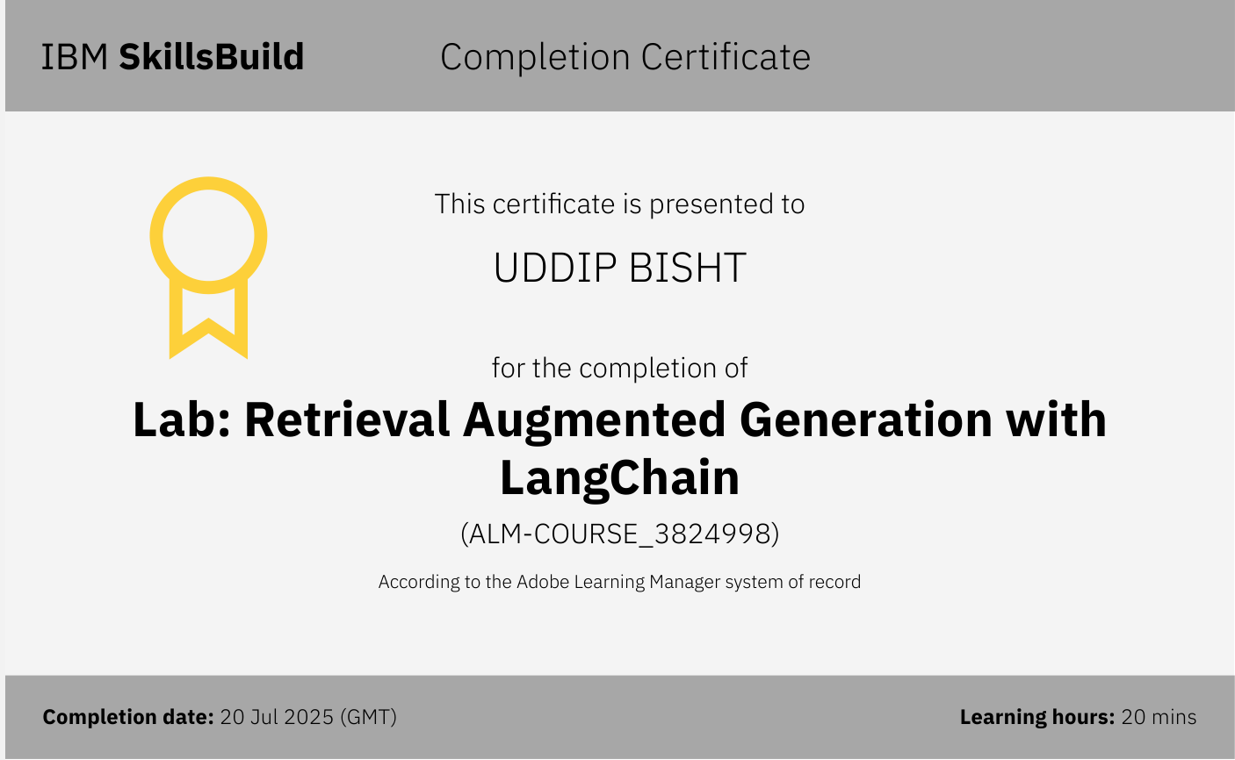
IBM Certifications
Certificate (RAG Lab)

Slide 19
THANK YOU

